Slide 1
Fire Safety
Artificial Intelligence Capstone

Slide 2




MEET THE TEAM
Fire Safety
Dheeraj Reddy
Purnima Yadav
Tech Lead
Team member
AI Researcher, Computer Vision developer
Toronto, Ontario, Canada
AI/ML Researcher, Big Data Analytics
Brampton, Ontario, Canada
Ayush Parolia
Ramesh Krishna
Team member
Team member
Data Scientist, Business Analyst, Developer
Toronto, Ontario, Canada
AI Researcher, MLOps
Toronto, Ontario, Canada

Slide 3
AGENDA
Fire Safety
1
Business Problem
2
Methodology
3
Solution Architecture
4
Model and algorithm
5
The Application
6
Conclusion and Future Directions

Slide 4
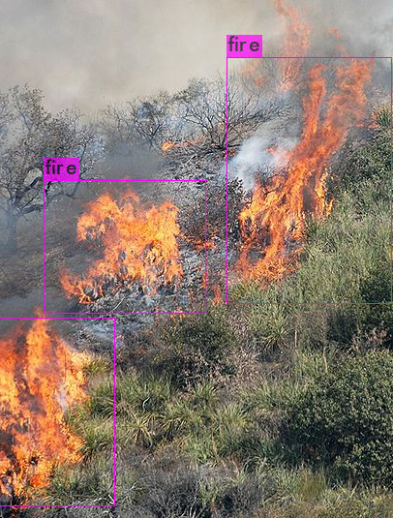
Business Problem
Fire Safety
Motivation
From 2009 to 2018, there were 113,111 fires with loss reported to the OFMEM.
Out of which 47% of these fires occurred in Residential occupancies and 27% occurred in vehicles.
Objective
Our objective is to detect this fires early using Artificial Intelligence to avoid the catastrophe.

Slide 5
Methodology
Fire Safety
Live Fire Detection
Live Surveillance feed will be taken to the backend.
Predictions will be done on the cloud based server and will be displayed on the screen.
Once fire is detected, the users will be notified by alarms, email etc.

Slide 6
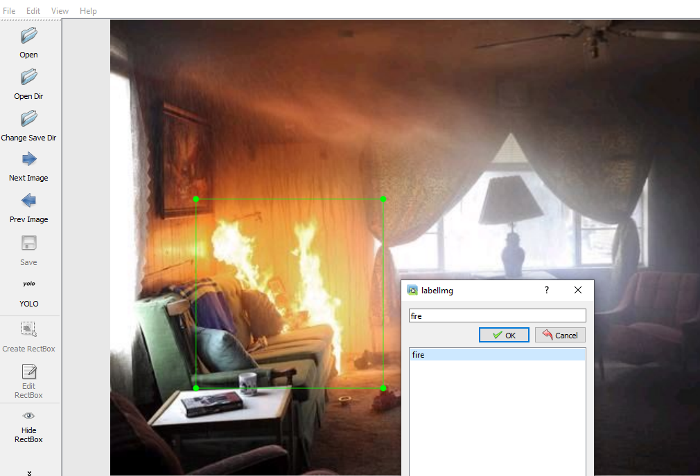
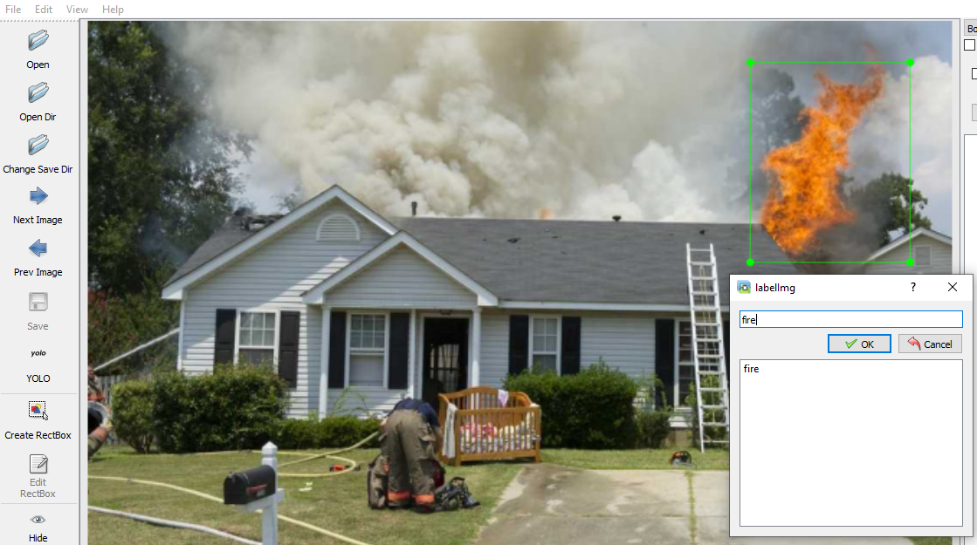
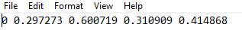
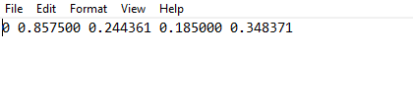
Annotations
Annotation Tool used is labelImg from https://github.com/tzutalin/labelImg
Displayed sample annotations and generated text outputs
Fig. 2 One fire image being annotated
Fig. 3 One fire image being annotated

Slide 7
Solution Architecture
Fire Safety
AI Model to Detect Realtime Fires
Web Based Application to detect the Fire on Videos
Fire Detection & Identification
Store incidents on a database.
Email groups to solve problems

Slide 8
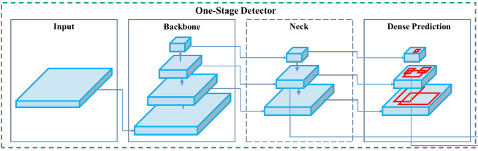
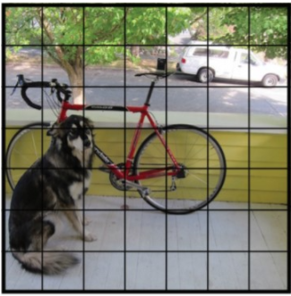
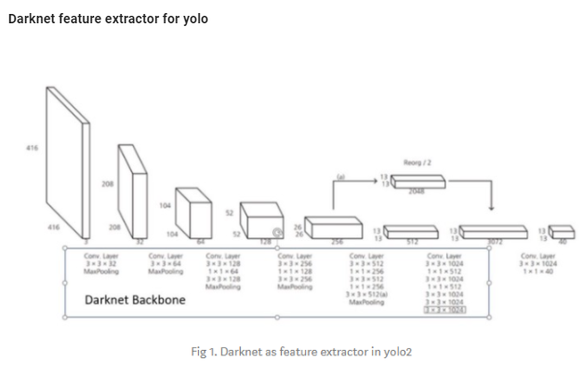
Model and algorithm
Fire Safety
YoloV4 object detection model

Slide 9
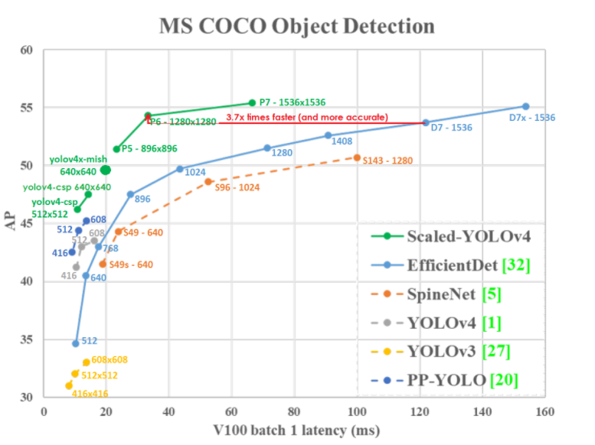
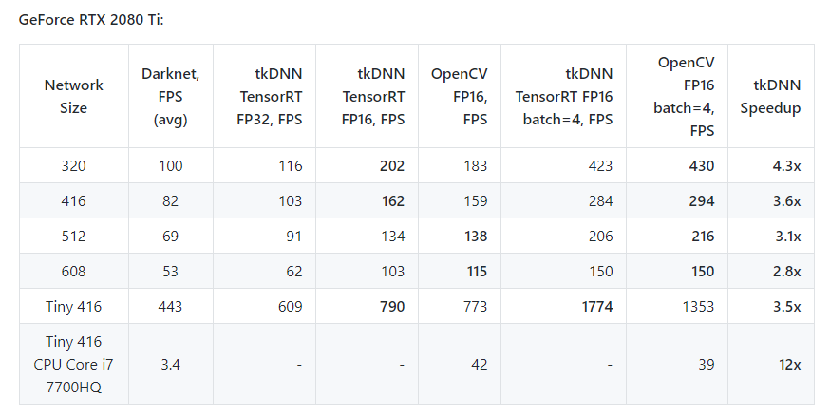
Model and algorithm
Fire Safety
YoloV4 model benchmark

Slide 10
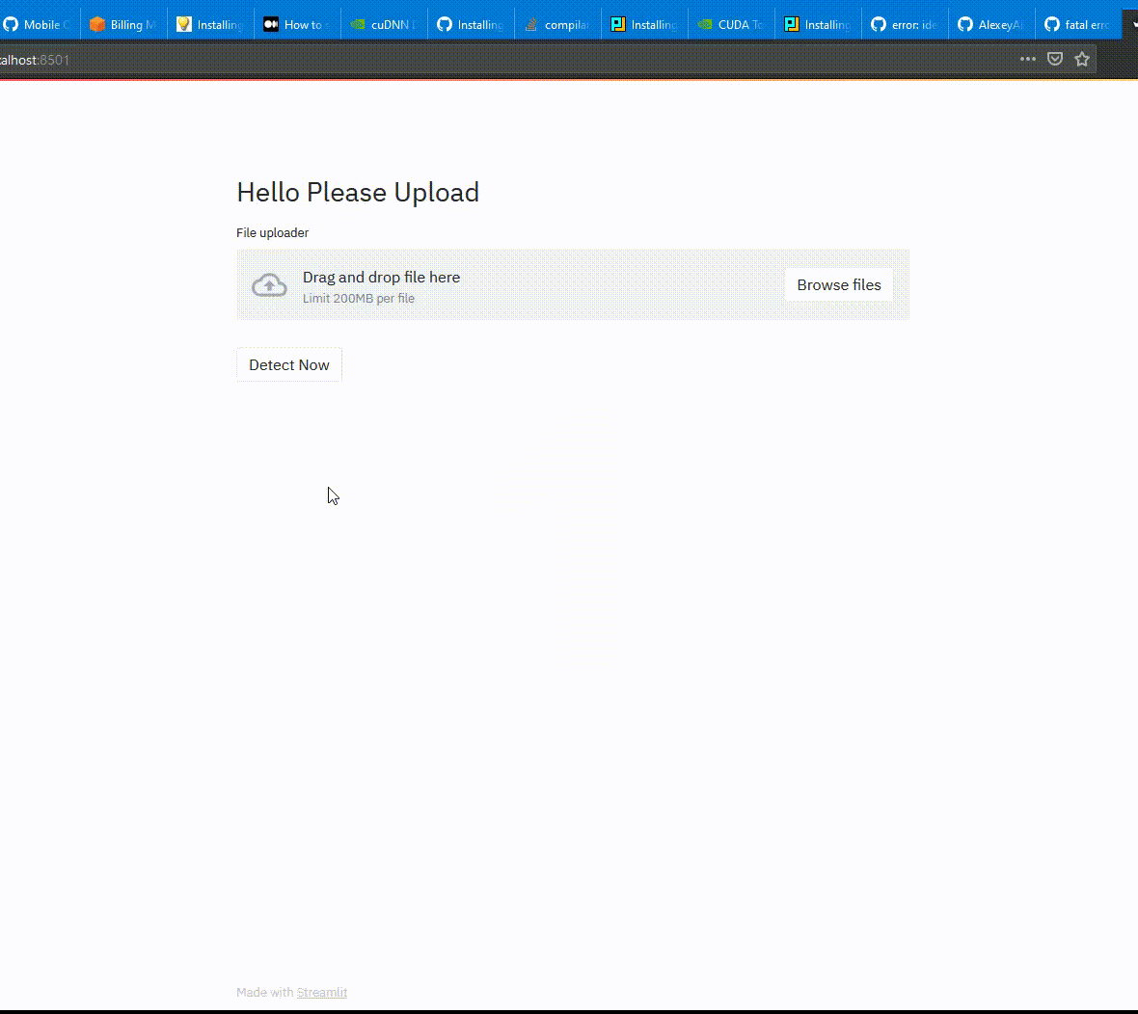
Web Application
Detect Fire
A Web Application is developed to upload the video and predict whether there is any fire detected on it
Web based application is deployed using AWS EC2 instance on Ubuntu 20.4 GPU server – Tesla K80
Weblink : http://18.221.225.6:8501/

Slide 11
Conclusion and Future Directions
Fire Safety
Future Scope
Large scale deployment using TensorRt.
Saving the Fire incidents in database for further analysis in future.
Alerting and notifying concerned authorities using email or text messages etc.
This model can be trained and extended to other classes.
Conclusion
AI model is developed to detect the fire incidents using images or videos.
Model is deployed using AWS CUDA, NIVIDIA cuDNN enabled GPU servers.

Slide 12
DEMONSTRATION
Fire Safety

